Slide 1

NBA Team Schedule Dashboard
By: Jena Hyunjeong Lim, Scott Wais, Jewon Ju, Mawada Felemban, Mei Lan Loh, Dali Durazo - Group 6

Slide 2
NBA Schedule Visualization Tool
Abstract: NBA decision makers are tasked with creating a schedule that is fair for all teams. To help inform scheduling decisions, we built a dashboard that visualizes the travel schedules for every National Basketball Association (NBA) team, from the 2008-2009 season to the present.
Users can filter the dashboard by team and season, allowing them to view travel patterns and key metrics over a specific date range. They can explore how average and total travel distance during a particular season affects winning percentage, and can pinpoint specific weeks in which a team traveled more or less than the league average.
Users can quickly discover teams’ most difficult travel stretches each season and can determine where certain teams are disadvantaged. For example, teams that are closer to their conference opponents tend to travel less distance on average.
Notes:
Title page and abstract (1 slide). You must prepare a title page with an appropriate title and abstract. The abstract should go on the title page. An abstract is a very high-level written summary of the entire project. Main points and findings only. We found that each teams average distance traveled is different. Further, the league average for cumulative distance traveled increases in a. The distances that teams traveled throughout each portion of the season is consistent, meaning that their distances stay the same regardless of when the game is played. The NBA eradicated scheduling four games in five days starting this season, showing the NBA’s willingness to improve scheduling for the players.

Slide 3
Business Problem
The NBA needs to create a balanced schedule each season
Two use cases:
NBA executives
Could utilize an interactive visual tool to compare potential schedules
Could assess progress toward scheduling improvement
Team general managers
Could see how their team ranks in terms of distance traveled
Could monitor team performance during difficult travel stretches
Notes:
Too much travel can lead to fatigue, higher injury risk, and increased mental stress, all of which can negatively impact team performance
Therefore, we created this dashboard with two use cases in mind:
NBA executives could utilize an interactive visual tool to compare potential schedules before making their final decisions. They could also assess their progress toward scheduling improvement by analyzing the schedules for previous seasons.
In addition, team general managers could use the dashboard to see how their team ranks in terms of distance traveled, and they could monitor their team’s performance during difficult travel stretches
• Introduction (1-2 slides). This part introduces the reader to the business problem and data set. For example, if you are analyzing giraffe population growth data from southern Kenya, you should describe why this is an important problem to investigate and give the reader a review of pertinent background information about giraffes in Kenya. Basically, introduce the reader to the problem and why it is meritorious of investigation. This should be written at a very basic level (i.e., no mathematics or notation). Remember your reader, may not know anything about the area in which you are writing.

Slide 4
Data Set
Our data includes all 30 teams in the NBA (including 3 legacy teams)
Each row represents one game
For each game we captured:
Home team
Away team
Result
Season
Date game was played
Arena coordinates

Slide 5
Data Collection Process
Collected the arena data from Wikipedia with coordinates for all 30 teams
Manually added three legacy teams that changed names in the past 12 years
Used sportsipy API to scrape 14 seasons of NBA schedule data
Includes all the game results for every team
Manually cleaned team abbreviations to match those in the arena locations table

Slide 6
Data Cleaning Process
Grouped data by season to ensure we collected the correct number of games
30 teams x 82 games = 2,460 per season
However, there were circumstances that contributed to a few seasons having fewer regular season games than normal
2012 (Lockout Year) - No agreement between players and league on CBA
Season began in December rather than late October
2013 (Boston Marathon Bombing)
1 missing game between Celtics and Pacers
2020 (Covid Begins)
Season stopped on March 12th and resumed June 2020
2021 (Covid Continued)
Number of games reduced because the season started in December rather than October
Notes:
Collected the arena data from Wikipedia with locations for all 30 teams
Manually add in three legacy teams that changed names in the past 12 years
Ran the scraper, with all the game results for every team
Manually clean some of the abbreviations to match those in the location file
Cleaning: map the arena coordinates to the scraped schedule data and To check whether the scrapping was done properly, groupby season and counted all the entries we had and made sure it matched with all 2,460 games in a season (30 teams x 82 games)
2012 was the lockout year, didn't start playing games until December because
2013 missing 1 game between Celtics and opponent because of Boston Marathon Bombing
2020 stopped midseason because of covid and 2021 the games started later than usual to reflect the adjusted schedule of 2020
However there were two covid seasons that included less regular season games than normal
And 1 lockout year that also included less regular season games

Slide 7
Feature Engineering
Mapped the arena coordinates to the scraped schedule data
Distance Traveled
Using the arena coordinates and building in logic for whether the game was home or away, we calculated the distance traveled for each game
Cumulative Distance
Using the distance traveled we calculated the cumulative distance for each team in each season
Used datetime column to calculate binary variables for whether teams played:
Back to back games
3 games in 4 days
4 games in 5 days
Notes:
Distance Traveled
Back to Back
3 in 4
4 in 5
Cumulative Distance

Slide 8
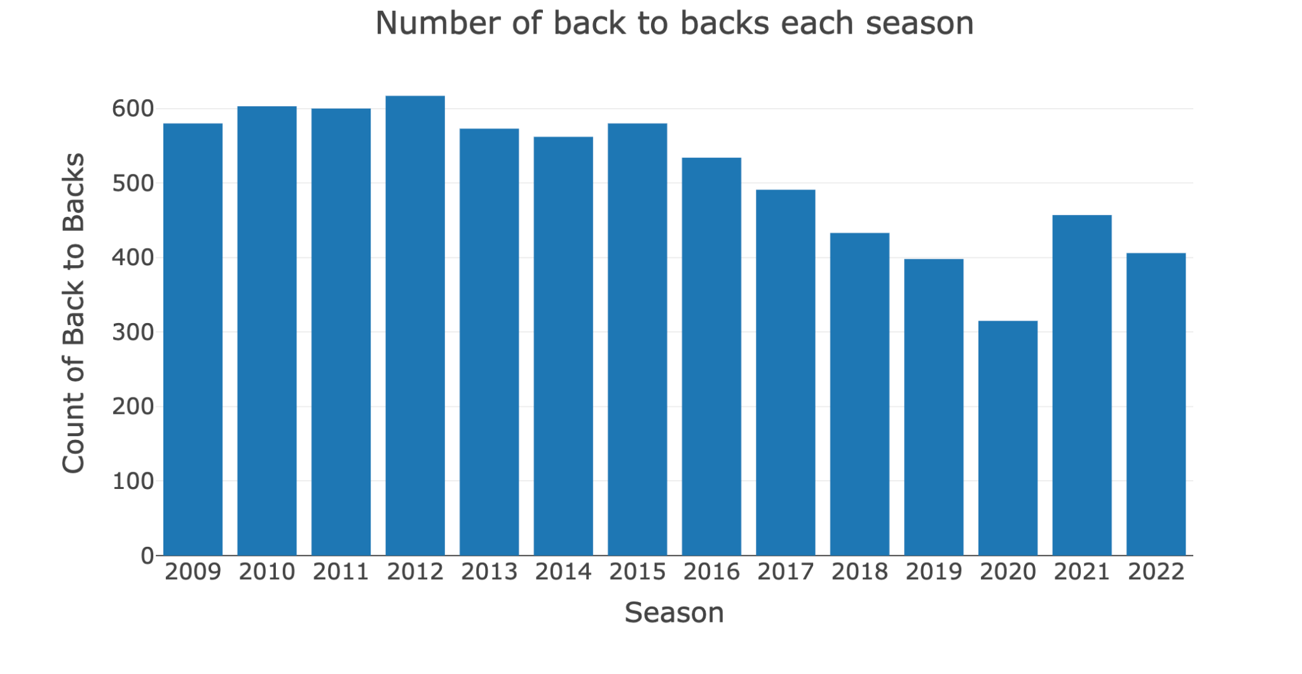
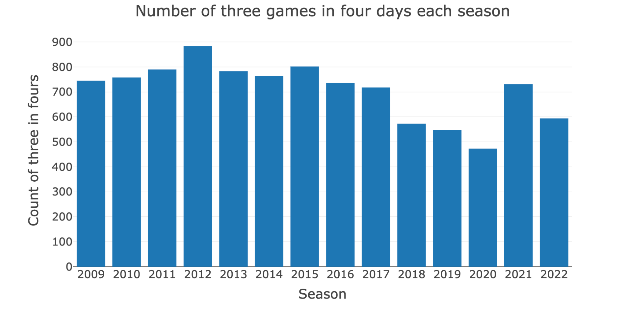
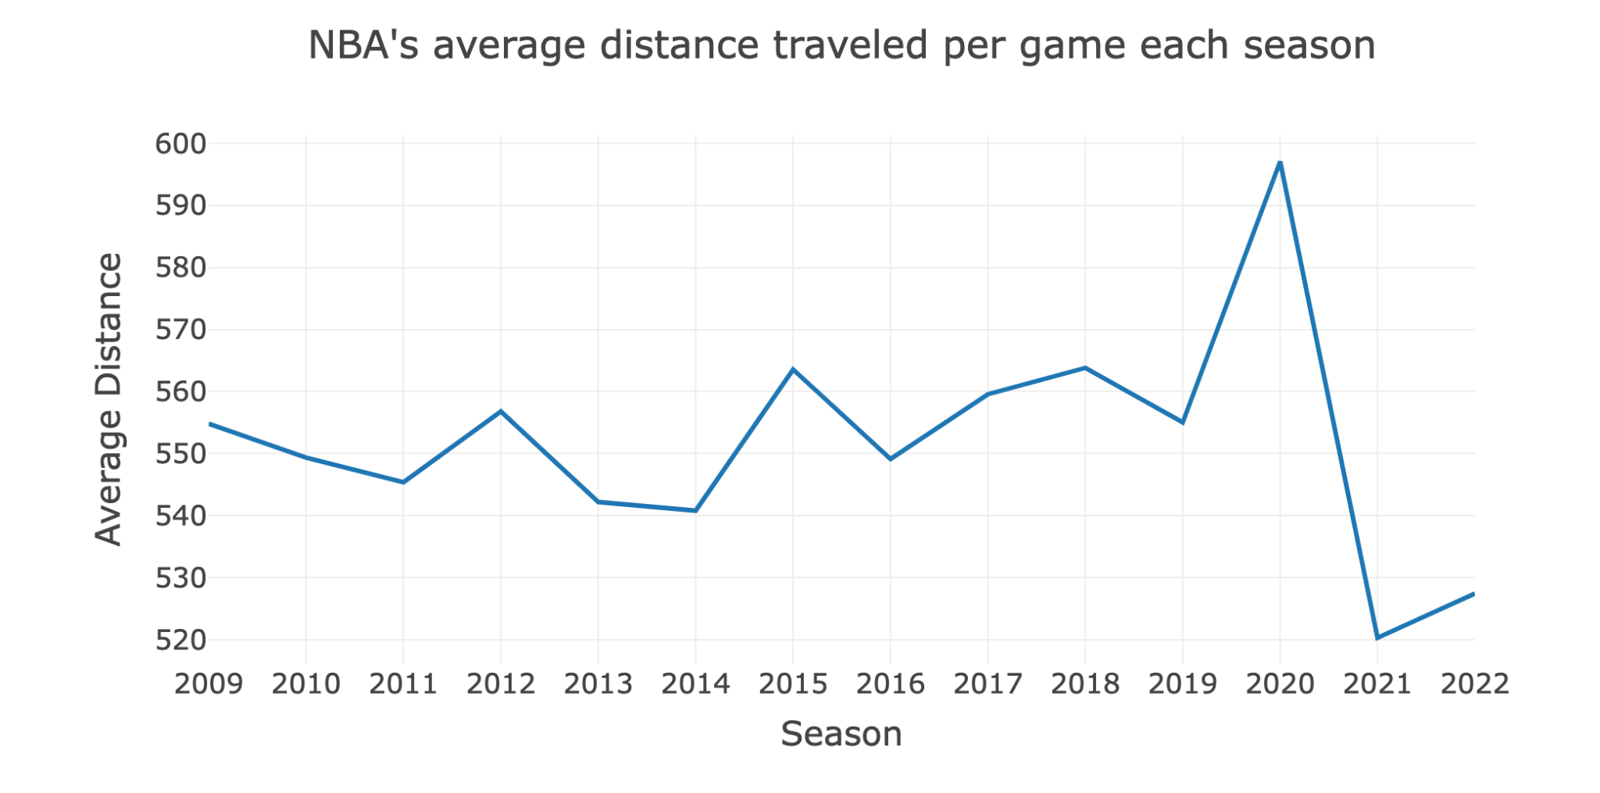
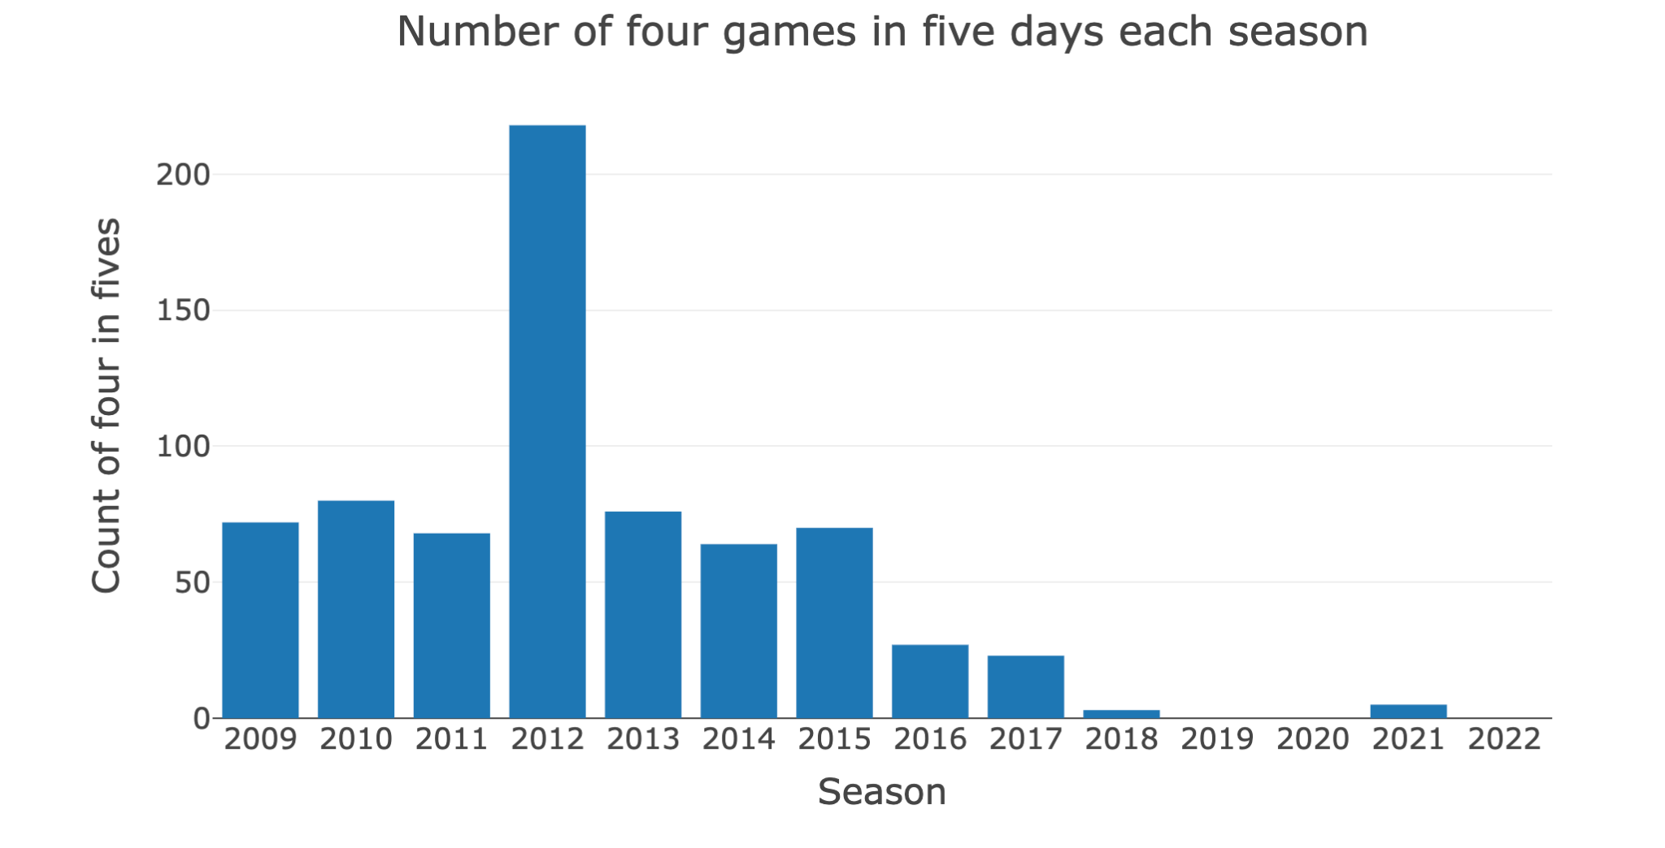
Exploratory Data Analysis
Notes:
The number of back to back games and three games in four days saw a steady decrease from the 2014-2015 season through the 2019-2020 season. The increase in the past 2021 could be attributed to the fact that it was a shortened season and there were not as many days for games. The NBA has all but eradicated playing four games in five days. Average distance of each season stayed roughly the same from 2009-2019 but the pandemic could have played a role in the increase in 2020 and sharp decrease in 2021.

Slide 9
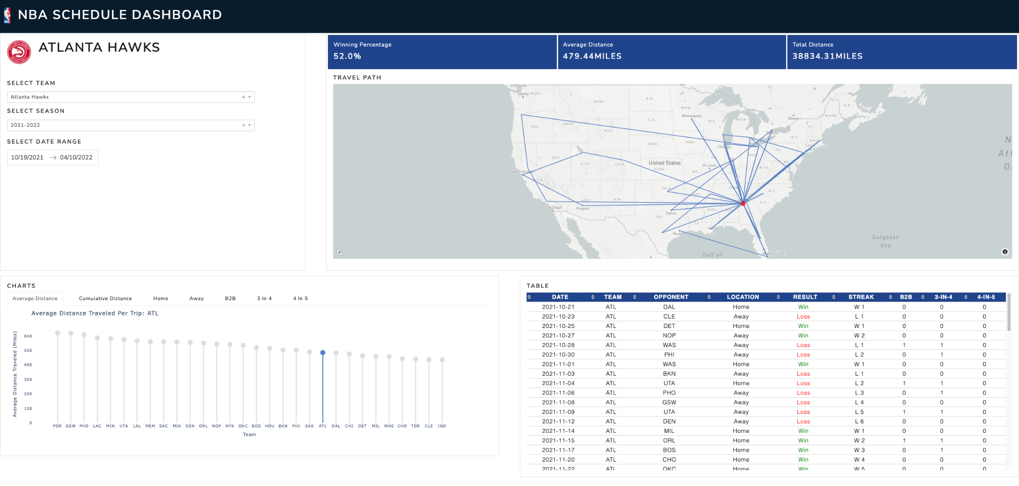
Dashboard Screenshots
Notes:
In this section, you are expected to explain who the potential user of the dashboard is, its design, and why it is important show the selected graphs, metrics, and tables.

Slide 10
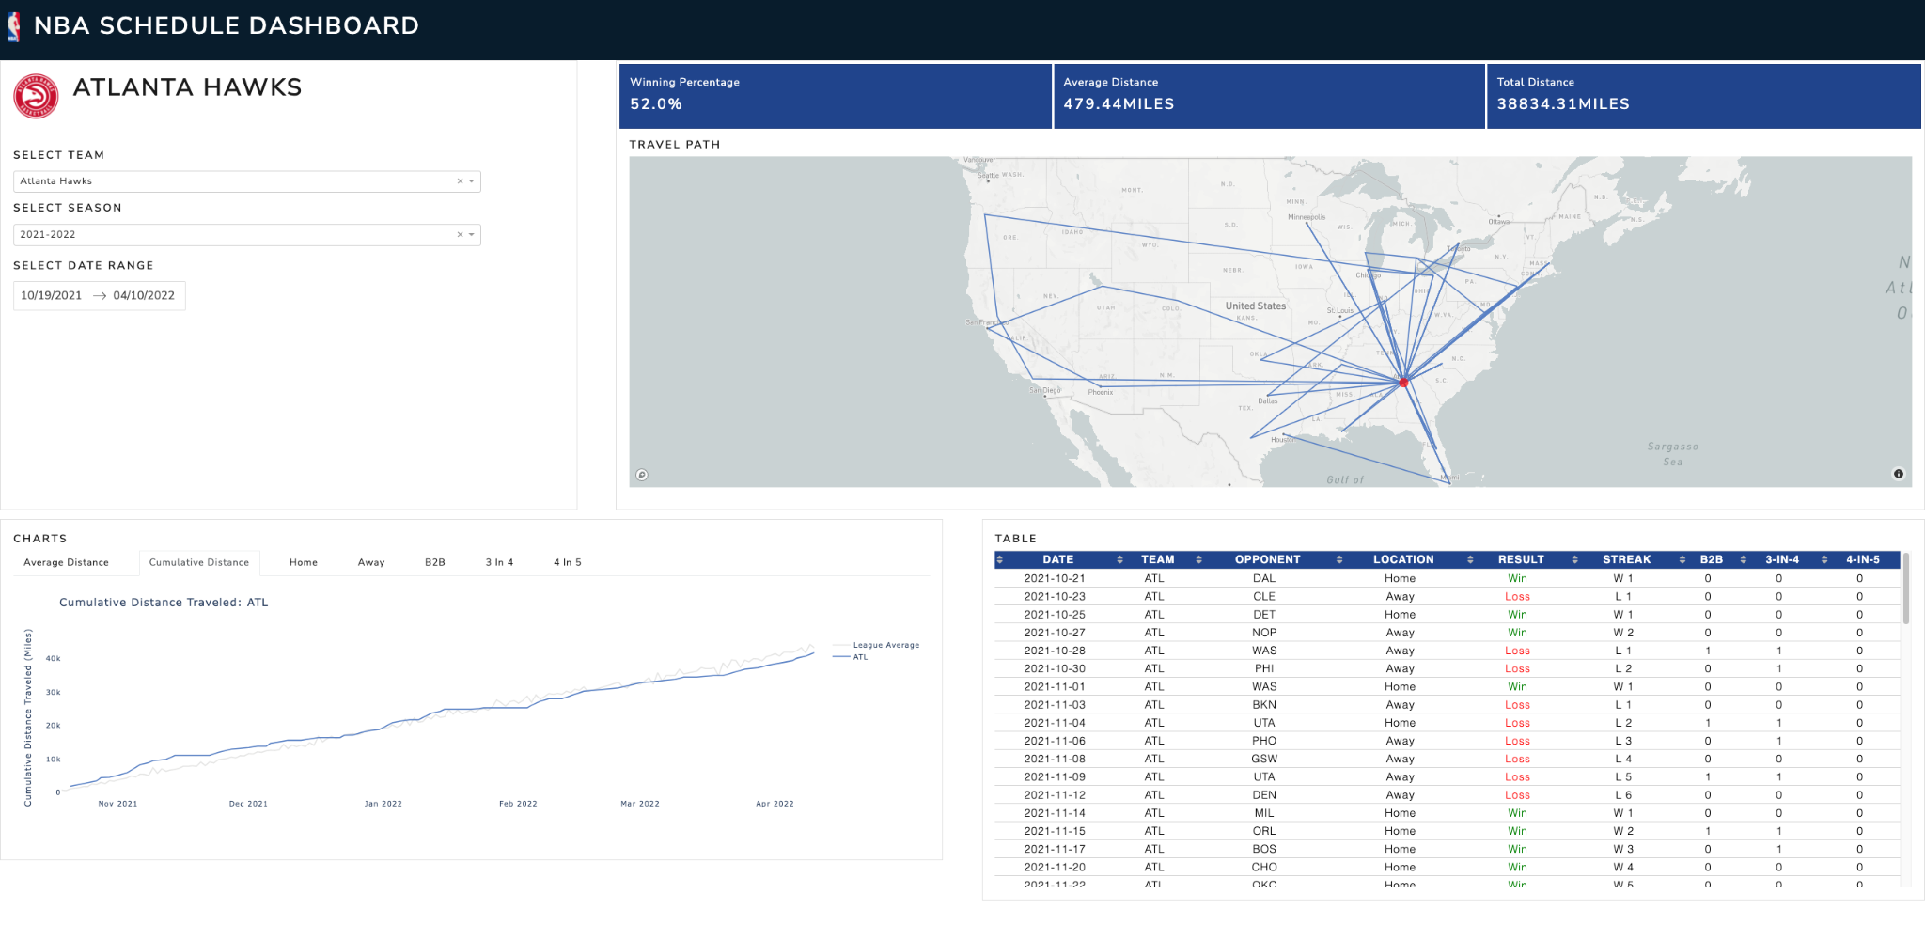
Dashboard Screenshots
Notes:
In this section, you are expected to explain who the potential user of the dashboard is, its design, and why it is important show the selected graphs, metrics, and tables.

Slide 11
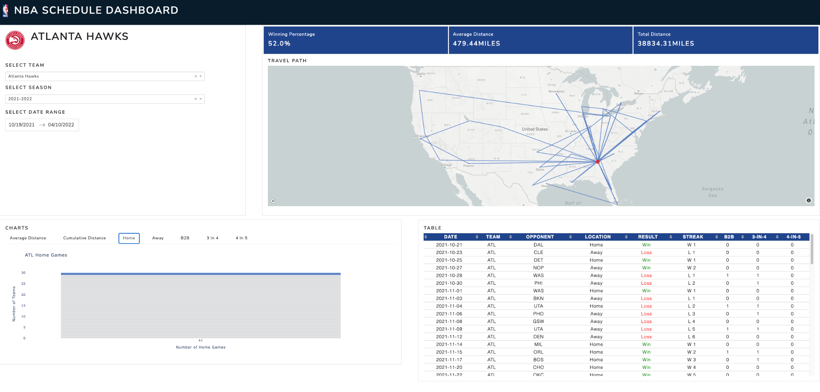
Dashboard Screenshots
Notes:
In this section, you are expected to explain who the potential user of the dashboard is, its design, and why it is important show the selected graphs, metrics, and tables.

Slide 12

Dashboard Screenshots
Notes:
In this section, you are expected to explain who the potential user of the dashboard is, its design, and why it is important show the selected graphs, metrics, and tables.

Slide 13
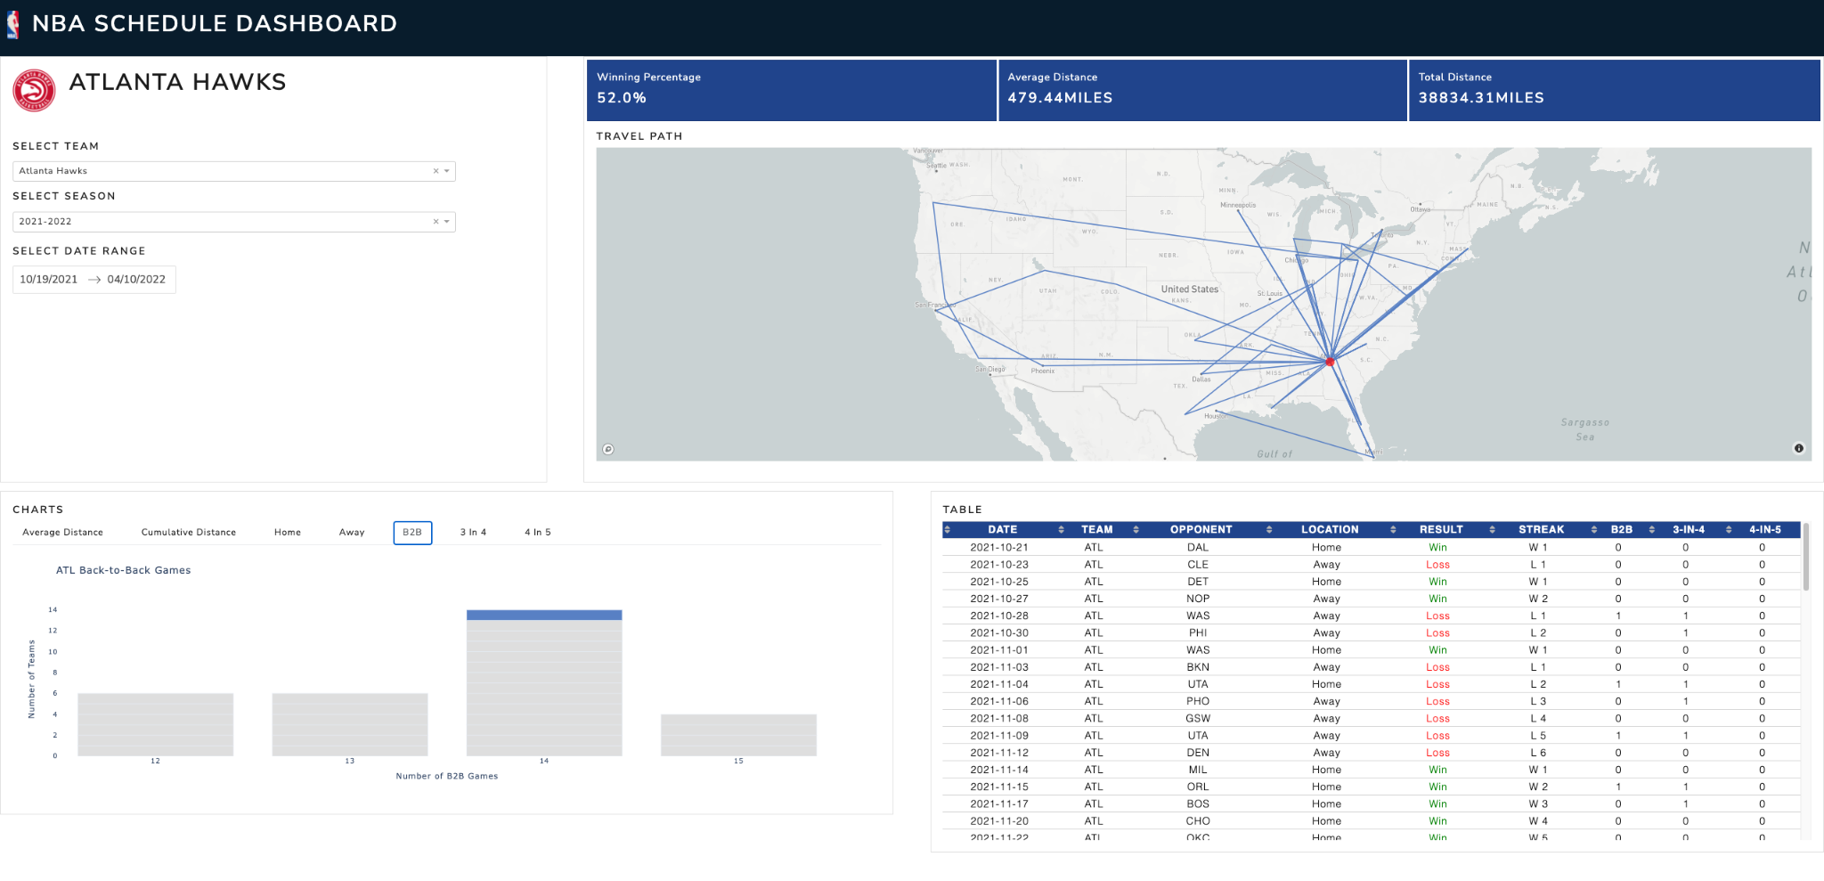
Dashboard Screenshots
Notes:
In this section, you are expected to explain who the potential user of the dashboard is, its design, and why it is important show the selected graphs, metrics, and tables.

Slide 14
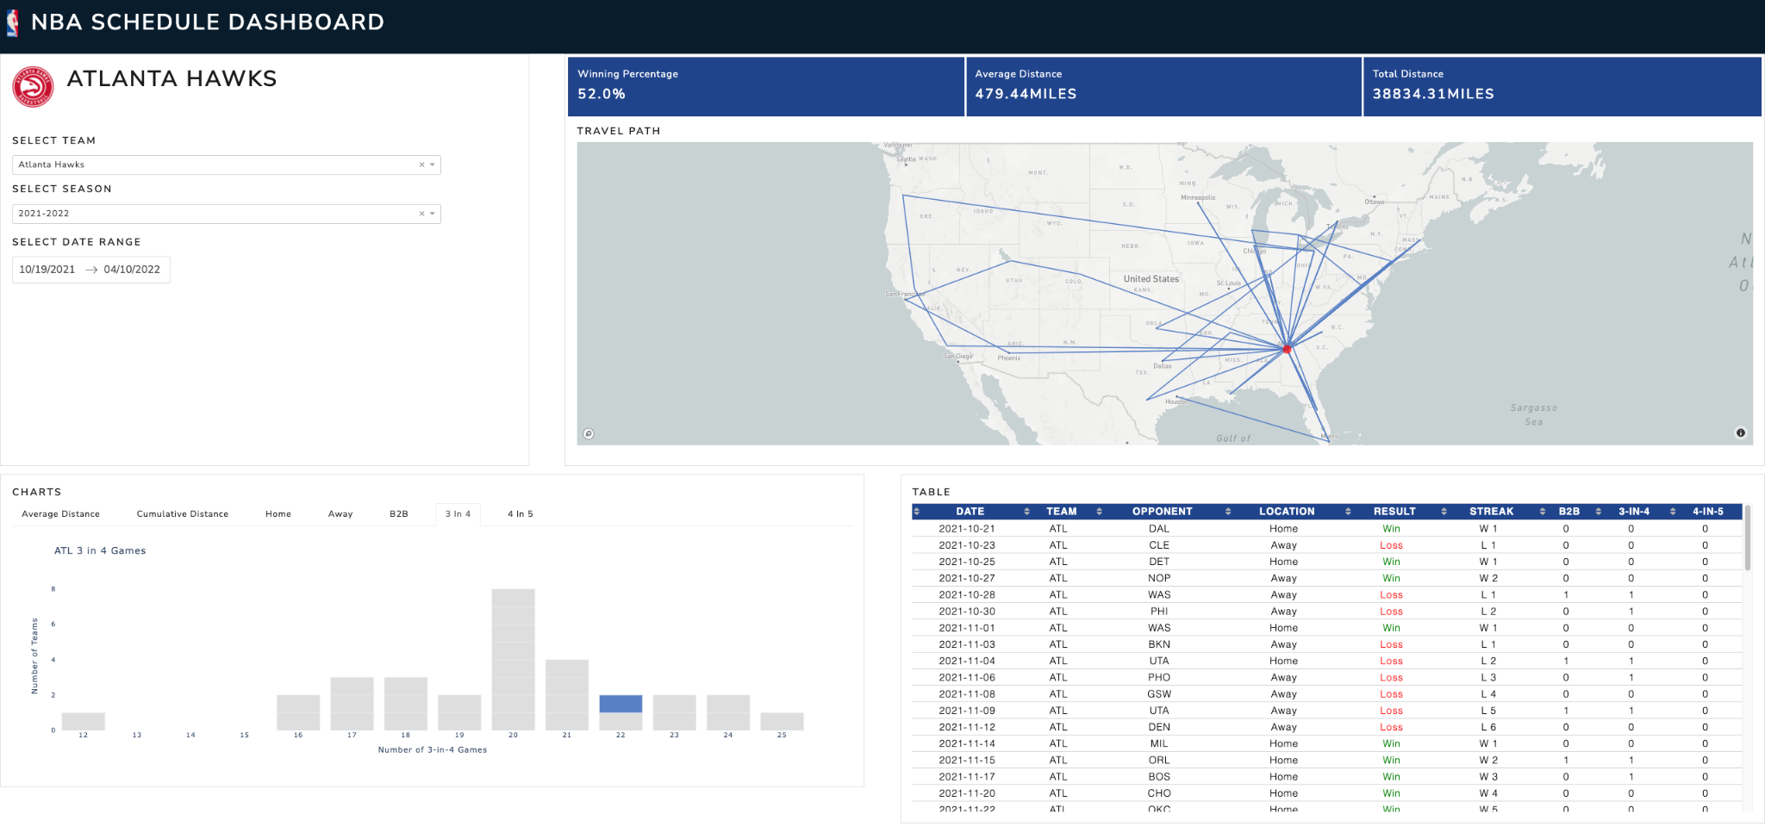
Dashboard Screenshots
Notes:
In this section, you are expected to explain who the potential user of the dashboard is, its design, and why it is important show the selected graphs, metrics, and tables.

Slide 15

Dashboard Screenshots
Notes:
In this section, you are expected to explain who the potential user of the dashboard is, its design, and why it is important show the selected graphs, metrics, and tables.

Slide 16
References
https://en.wikipedia.org/wiki/National_Basketball_Association#Teams
https://sportsreference.readthedocs.io/en/stable/nba.html#module-sportsipy.nba.schedule
https://www.math.cmu.edu/~af1p/Teaching/OR2/Projects/P49/21-393ProjectPaper_Group1.pdf
Notes:
Cite all reference.

Slide 17
Appendices
Github Repository
Notes:
Use appendices to catalogue extra graphics/plots/output. Basically, I use an appendix to house information that I want the reader to have access to but feel that it would interrupt the flow of the main body of the presentation.

